Slide 1

Hibernate Overview

Slide 2
Topics
•
What is Hibernate?
•
Benefits of Hibernate
•
Code Snippets
www.luv2code.com

Slide 3


What is Hibernate?
•
A framework for persisting / saving Java objects in a database
www.hibernate.org
Your Java App
Hibernate
www.luv2code.com

Slide 4
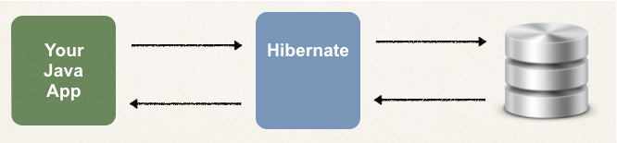
Benefits of Hibernate
•
Hibernate handles all of the low-level SQL
•
Minimizes the amount of JDBC code you have to develop
•
Hibernate provides the Object-to-Relational Mapping (ORM)
www.luv2code.com

Slide 5
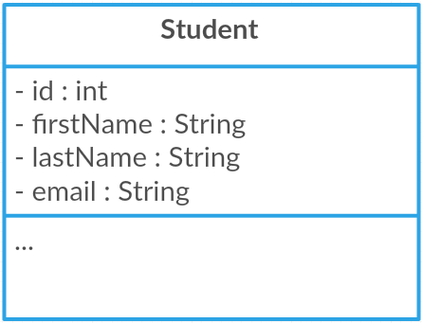
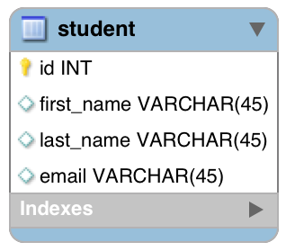
Object-To-Relational Mapping (ORM)
The developer defines mapping between Java class and database table
Java Class
Database Table
Hibernate
www.luv2code.com

Slide 6

Saving a Java Object with Hibernate
// create Java object
Student theStudent = new Student(“John”, “Doe”, “john@luv2code.com");
// save it to database
int theId = (Integer) session.save(theStudent);
www.luv2code.com

Slide 7

Retrieving a Java Object with Hibernate
// create Java object
Student theStudent = new Student(“John”, “Doe”, “john@luv2code.com");
// save it to database
int theId = (Integer) session.save(theStudent);
// now retrieve from database using the primary key
Student myStudent = session.get(Student.class, theId);
www.luv2code.com

Slide 8

Querying for Java Objects
Query query = session.createQuery("from Student");
List<Student> students= query.list();
www.luv2code.com

Slide 9
Hibernate CRUD Apps
Create objects
Read objects
Update objects
Delete objects
www.luv2code.com

Slide 10

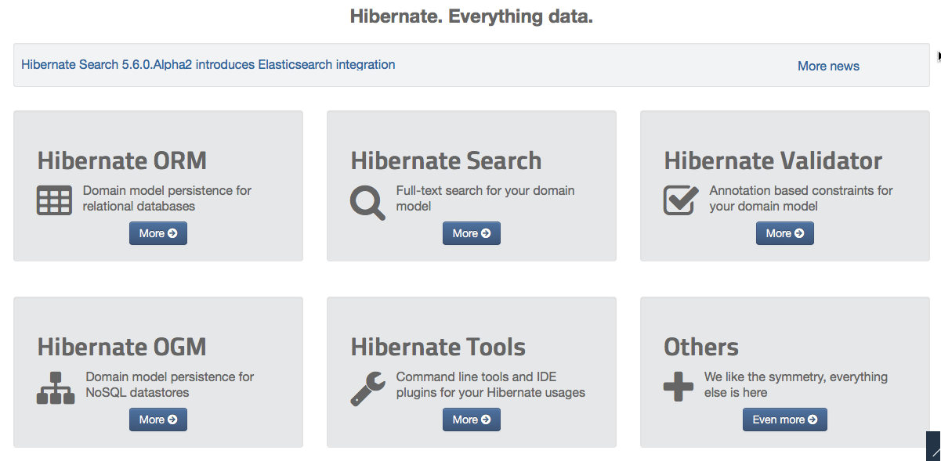
Hibernate is actually more than ORM!
www.luv2code.com

Slide 11



Hibernate and JDBC
•
Hibernate uses JDBC for all database communications
Your Java App
Hibernate
JDBC
www.luv2code.com

Slide 12
Hibernate Configuration

Slide 13
Hibernate Dev Process - To Do List
Add Hibernate Configuration file
Annotate Java Class
Develop Java Code to perform database operations
www.luv2code.com

Slide 14



Configuration File
Hibernate
JDBC
www.luv2code.com

Slide 15
Annotate Java Class

Slide 16

Terminology
Entity Class
Java class that is mapped to a database table
www.luv2code.com

Slide 17
Object-to-Relational Mapping (ORM)
Java Class
Database Table
Hibernate
www.luv2code.com

Slide 18
Two Options for Mapping
Option 1: XML config file (legacy)
Option 2: Java Annotations (modern, preferred)
www.luv2code.com

Slide 19
Java Annotations
Step 1: Map class to database table
Step 2: Map fields to database columns
www.luv2code.com

Slide 20

Step 1: Map class to database table
@Entity @Table(name="student") public class Student {
...
Java Class
Database Table
}
www.luv2code.com

Slide 21

Step 2: Map fields to database columns
@Entity @Table(name="student") public class Student {
@Id @Column(name="id") private int id;
Java Class
Database Table
@Column(name="first_name")
private String firstName;
…
}
www.luv2code.com

Slide 22
Save a Java Object

Slide 23
Hibernate Dev Process - To Do List
Add Hibernate Configuration file
Annotate Java Class
Develop Java Code to perform database operations
www.luv2code.com

Slide 24






Two Key Players
Class Description
SessionFactory | Reads the hibernate config file Creates Session objects Heavy-weight object Only create once in your app
Session | Wraps a JDBC connection Main object used to save/retrieve objects Short-lived object Retrieved from SessionFactory
www.luv2code.com

Slide 25

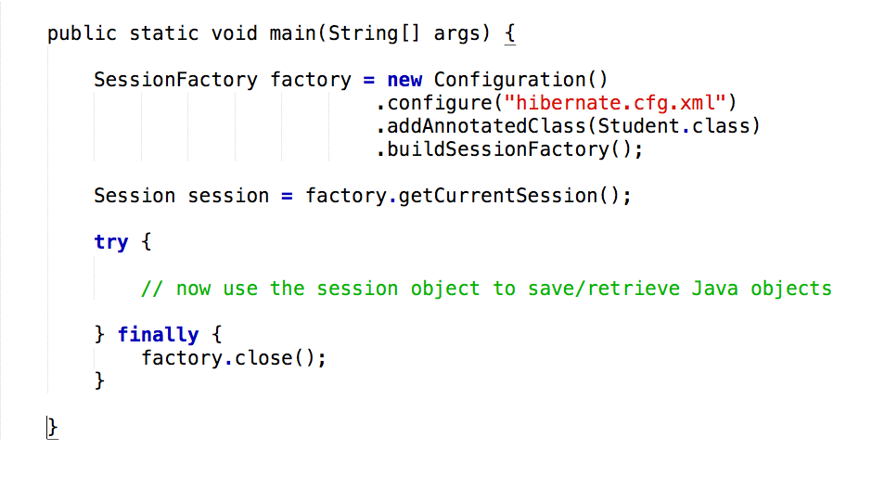
Java Code Setup
www.luv2code.com

Slide 26

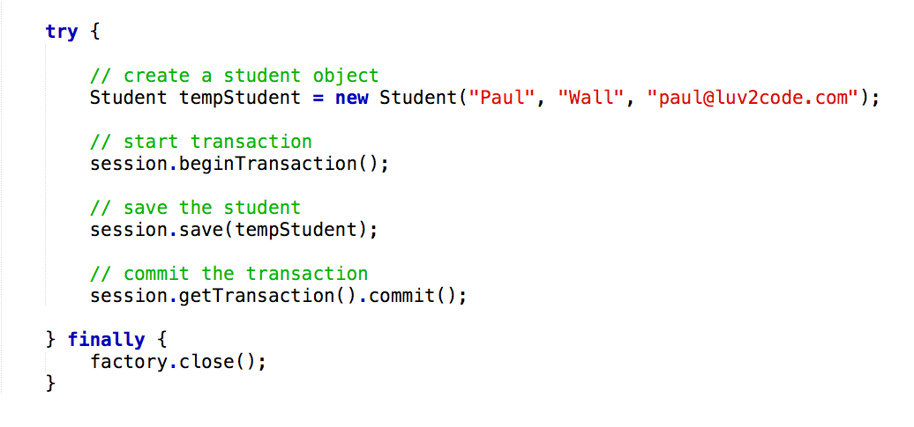
Save a Java Object
www.luv2code.com

